Slide 1
Interactive Public Data
Developed for NC Innovation Center

Slide 2
Project Summary
Visualize and display state data
Need to be charts or maps
Accessible to public
Needs to be appealing to use
Easy and intuitive to use
Utility for state employees
Assist decision-making
Notes:
I e

Slide 3



Clients
North Carolina Government
Office of Information Technology Services
Department of Environmental and Natural Resources
Also involved/interested: Department of Transportation
Contact Persons
Erik Ross, Lois Nilson, Eric Ellis
One videoconference, one face-to-face meeting, email
End-of-Project Goal
Display collected state data
Allow interaction by public
Be useful for state government decision-makers
Notes:
I e

Slide 4
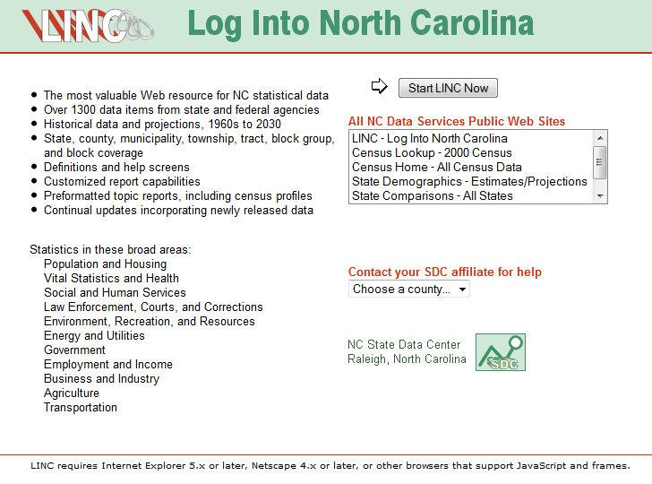
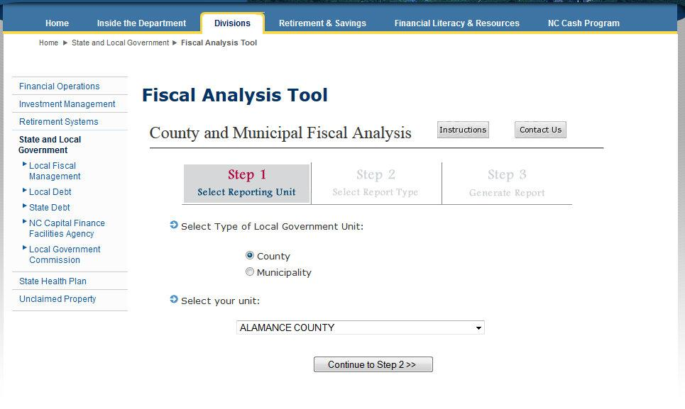
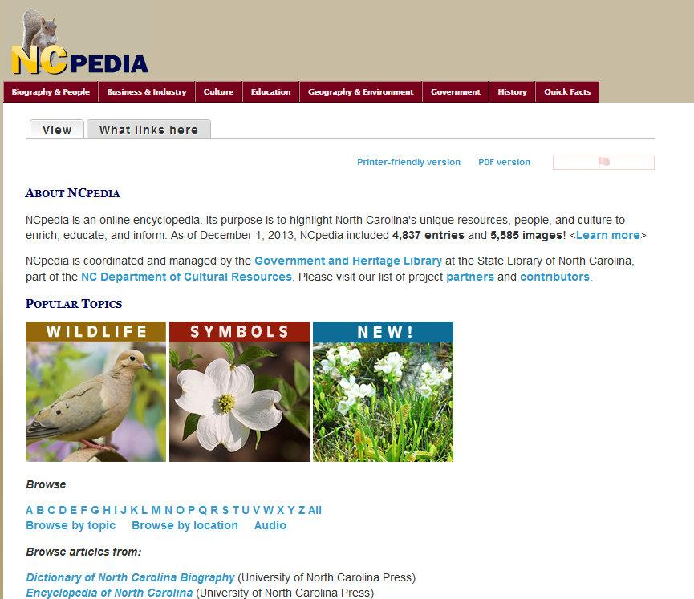
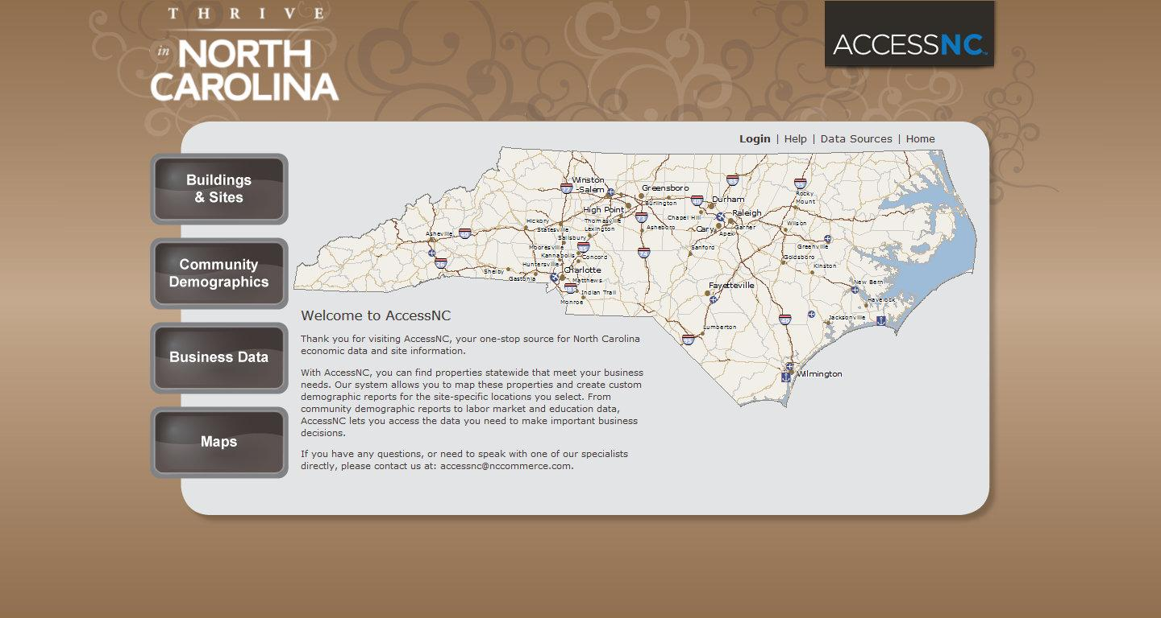
Existing Interface

Slide 5
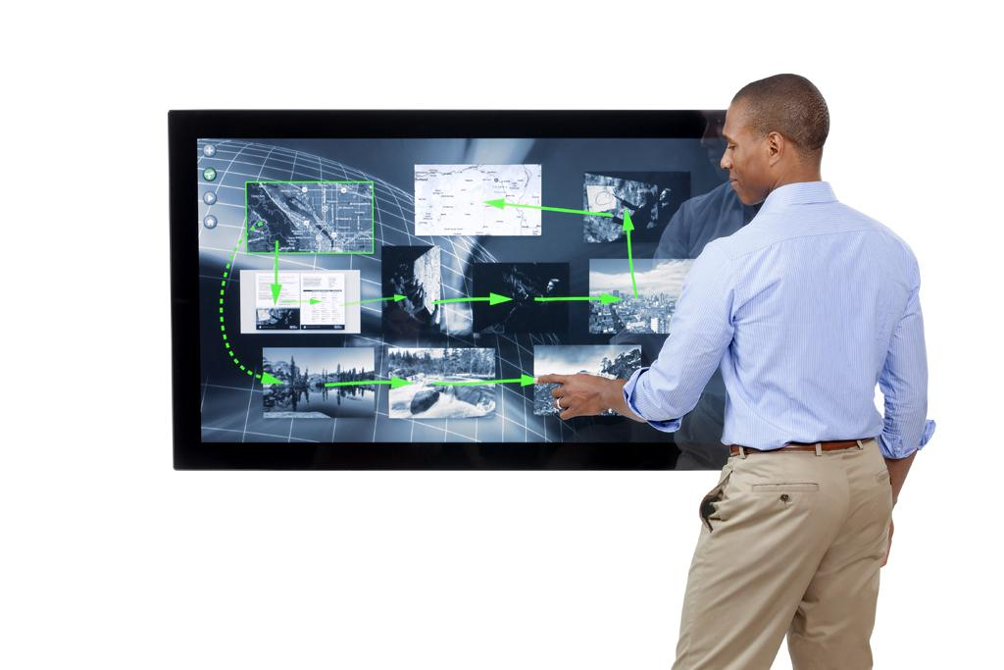
Innovation Center Facility
Size: ~1000 sq ft
Large (55”) touchscreens
Medium (47”) touchscreens
Small (23”) touchscreens
Notes:
I e

Slide 6
Initial Meeting

Slide 7
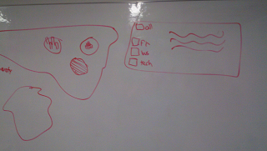
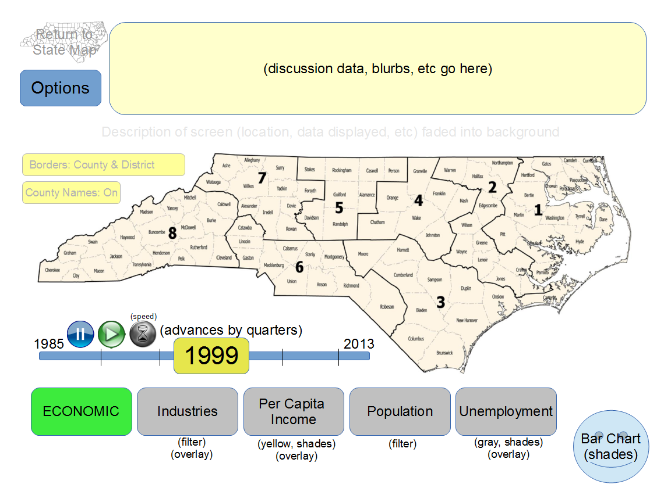
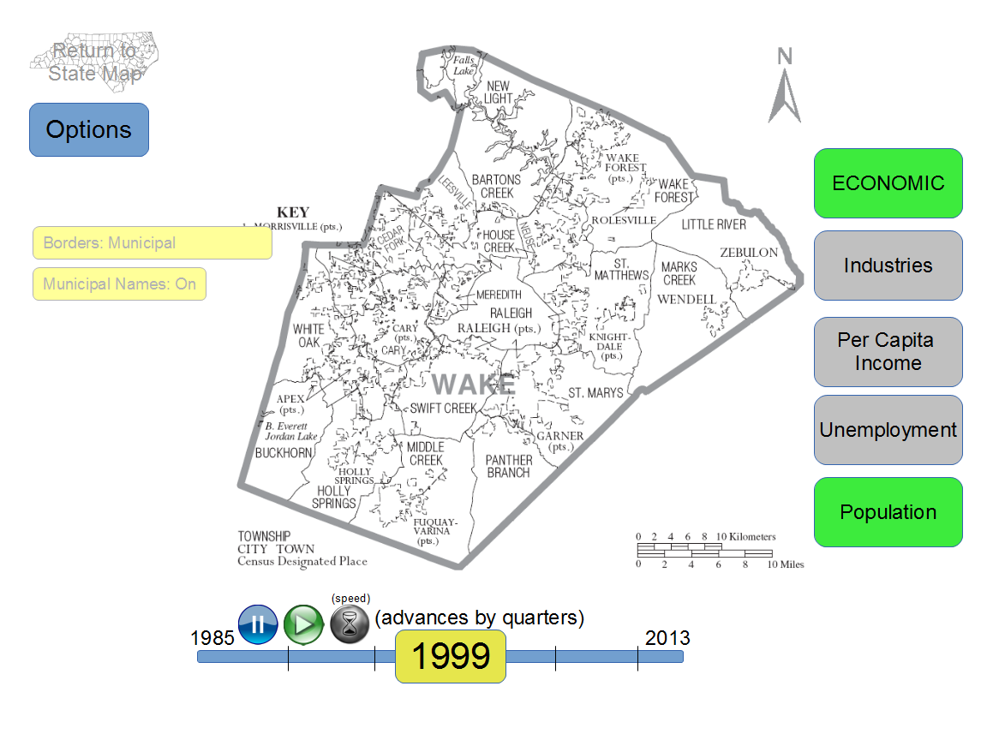
Early Designs
Notes:
I e

Slide 8
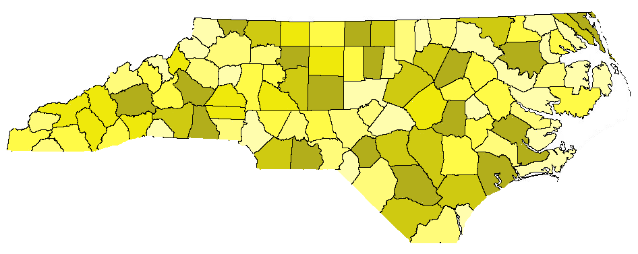
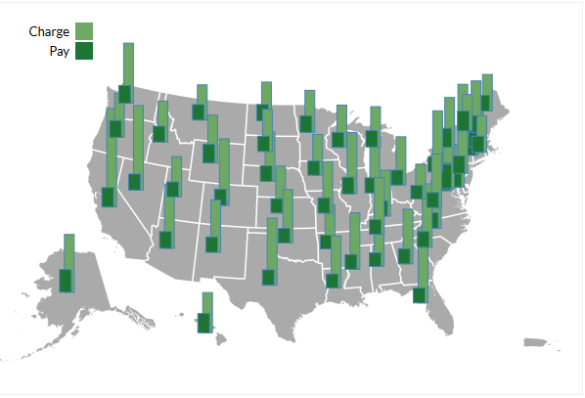
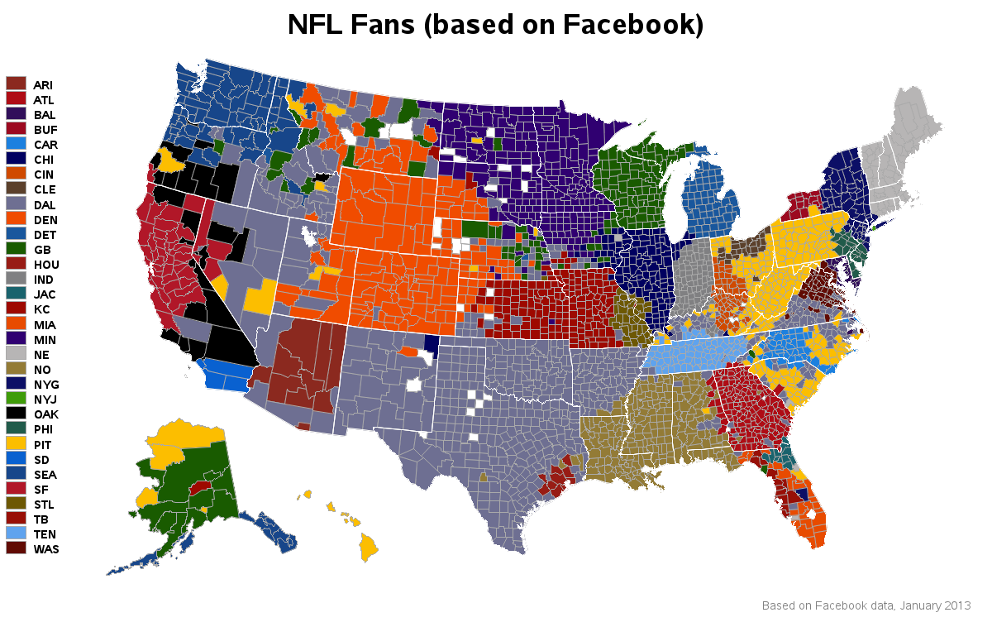
Data Visualization - static
Heat Map
Bar Graph
Colour Code

Slide 9
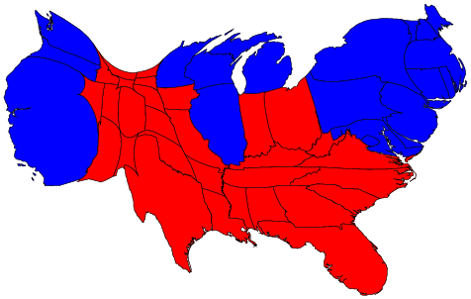
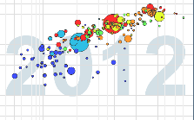
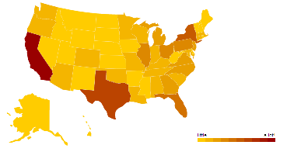
Data Visualization...
More Interactive!
Cartogram
GapMinder
Ammaps
Google Motion Charts

Slide 10
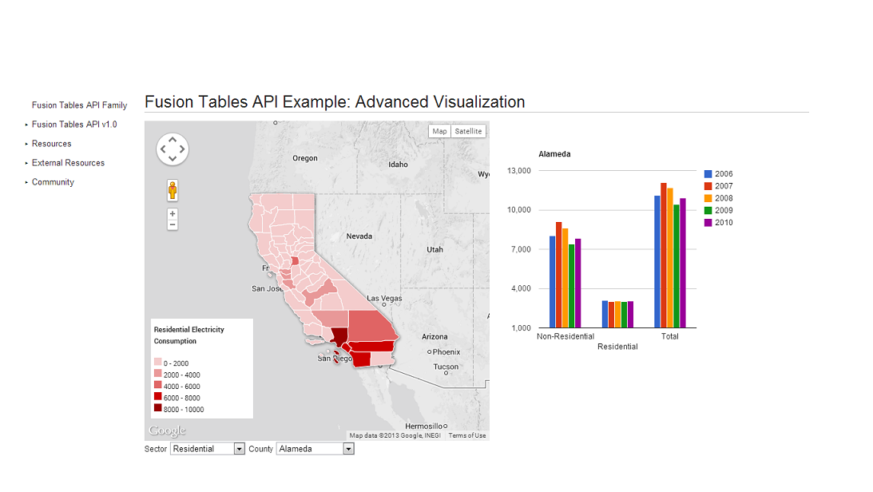
Google Fusion Tables(early designs)

Slide 11
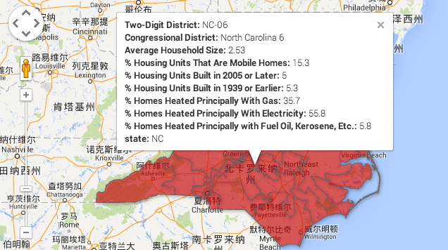
Combine with county boundary data
https://www.google.com/fusiontables/data?docid=1JaoSeepS2r7-ZvxwAA0f8y4Zuub1rJhrQh_WLvo#map:id=3

Slide 12
Facility Meeting

Slide 13
Prototype’s Data
Lots of different options
Budget
Transportation
Employment
Requirements
Straightforward use-case scenarios
Relative simplicity of data tables
Minimal repackaging from existing public reports
Notes:
I e

Slide 14
Existing Solutions
Google Charts
Easy to use
Rapid
Variety of options
Ammaps/Amcharts
Specialized
Customizable
Notes:
I e

Slide 15
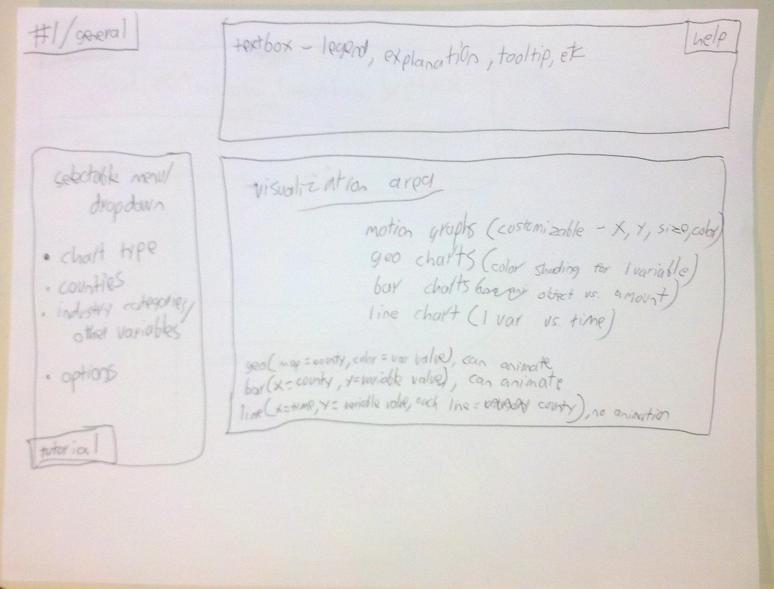
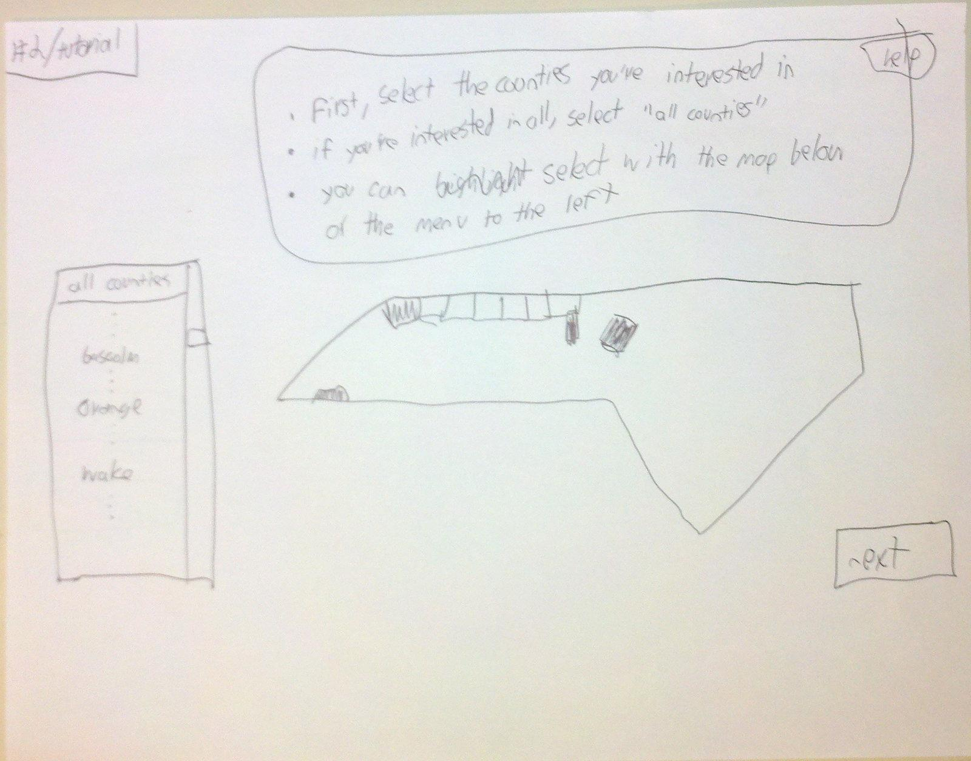
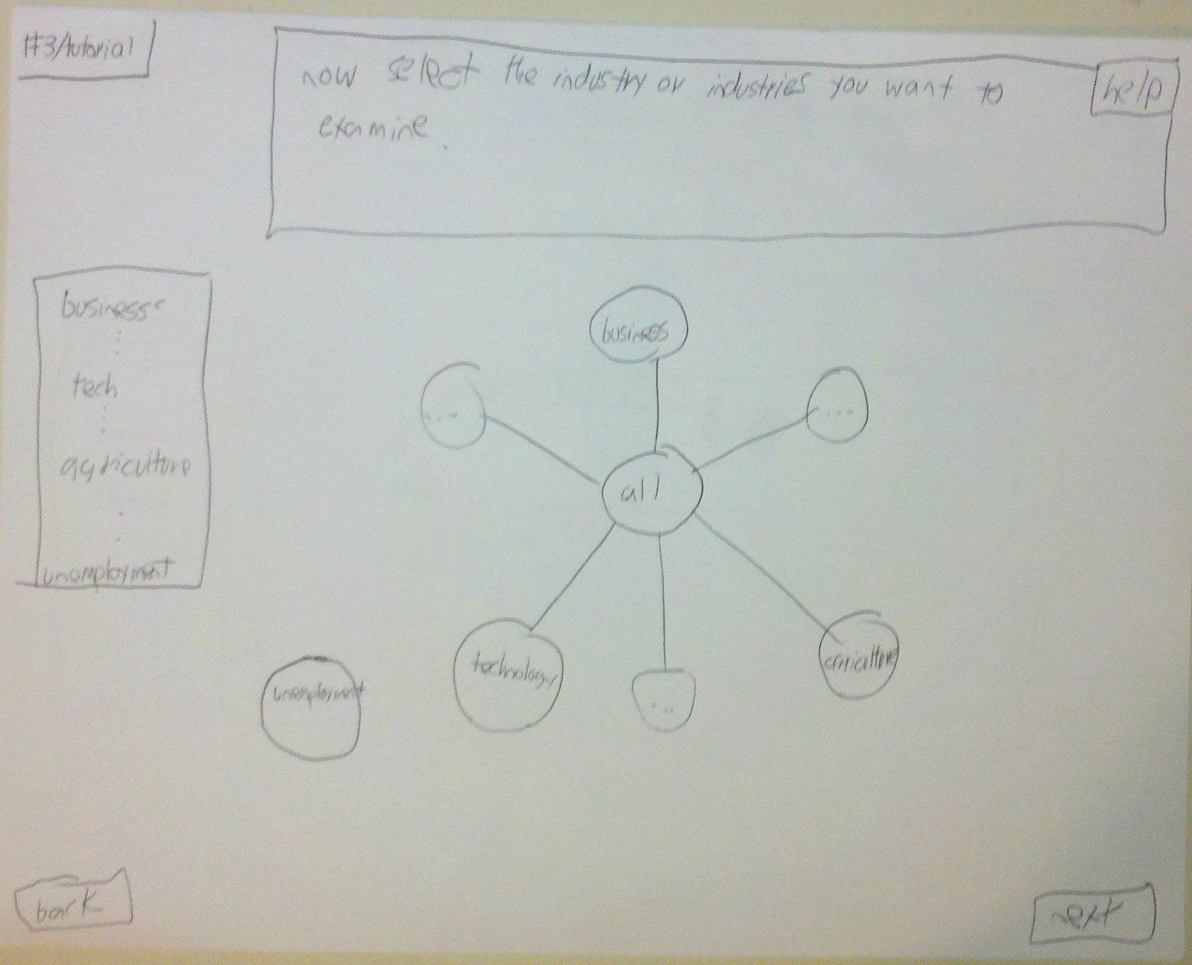
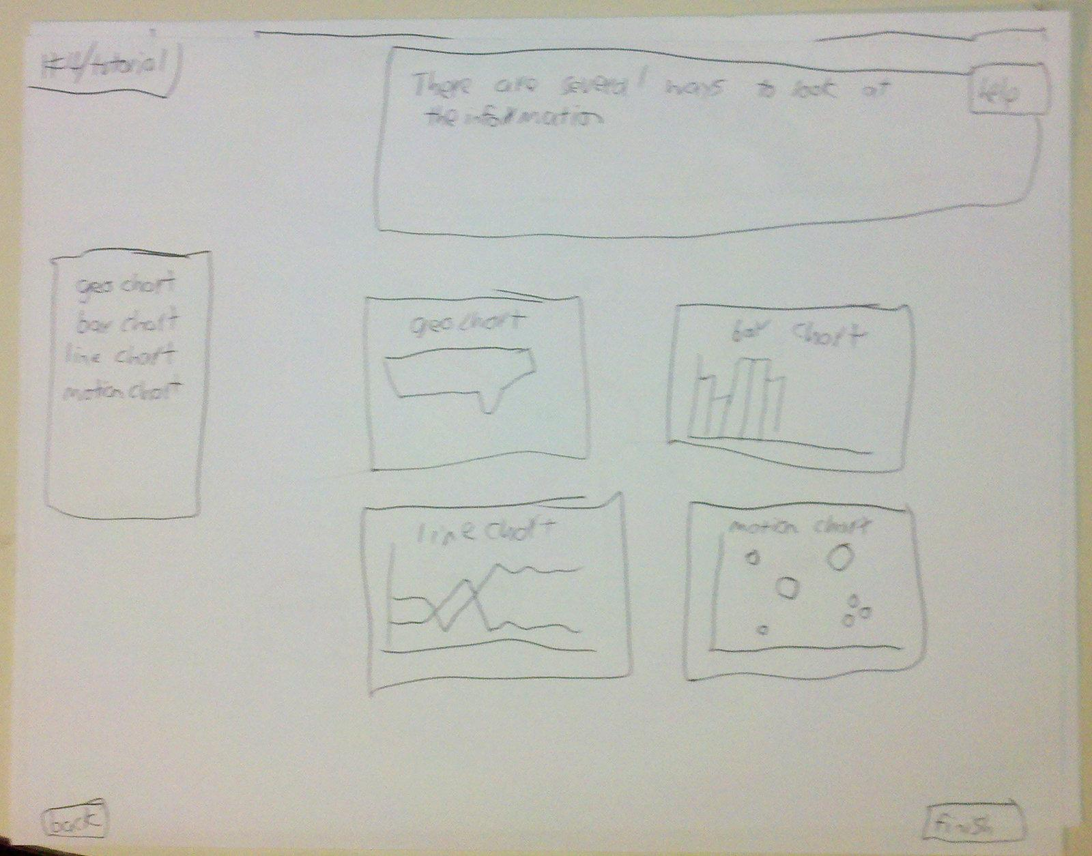
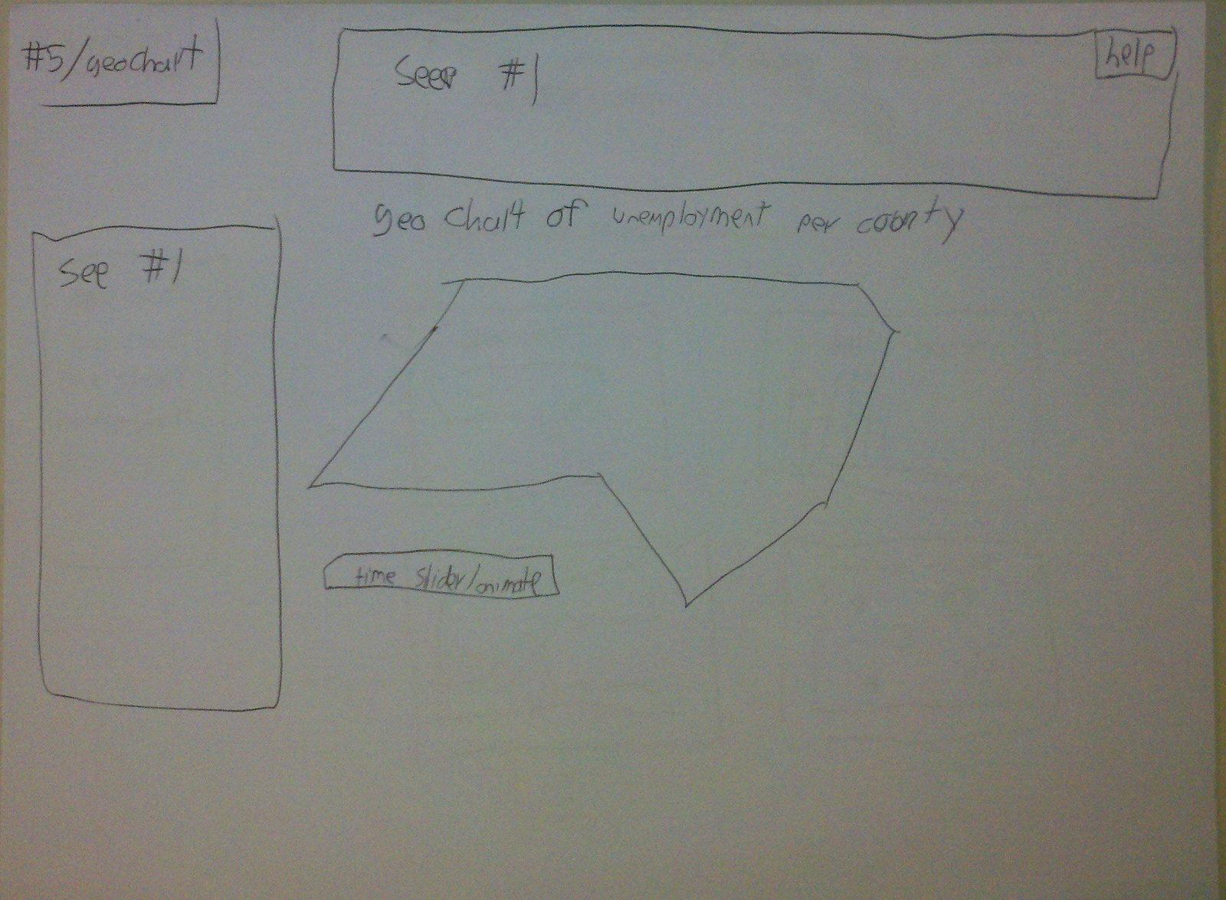
Storyboarding
Notes:
I e

Slide 16
User Survey
Design of the survey
Initial Client Feedback
Initial User Feedback
Changes based on feedback
Final User Feedback

Slide 17
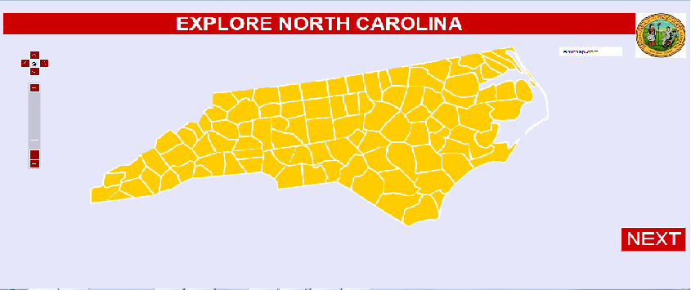
Feedback

Slide 18
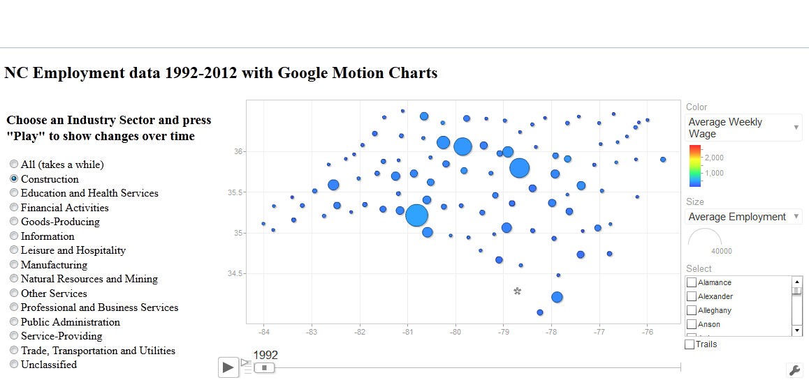
Feedback

Slide 19
Demonstration

Slide 20
(Future Paths)

